Slide 1
Discrete Mathematical Structures(CS241AT)
DEPARTMENT OF CSE
R V College of Engineering
Anitha Sandeep
Assistant Professor
Department of CSE
R V College of Engineering

Slide 2
Group Theory and Coding Theory
Unit 5

Slide 3
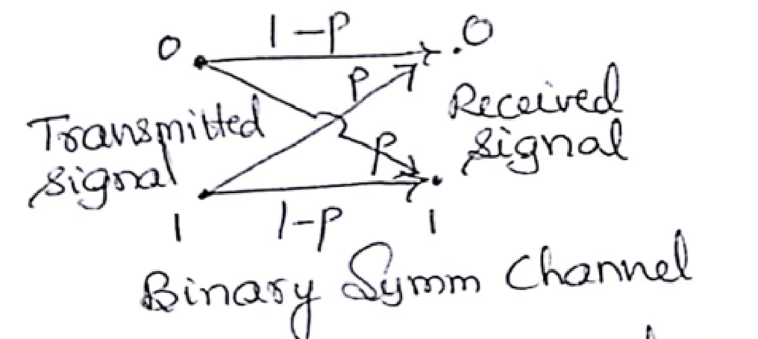
Coding Theory
In digital communication, information is transmitted in the form of binary strings of 0s and 1s. As a result of noise in the channel, a certain signal transmitted may not be received as it is, causing the receiver to make wrong decision. So, techniques are developed to detect and even to correct transmission errors. But we can only improve the chances of correct transmission. The model uses binary symmetric channel shown below:
Binary Symmetric Channel:
Binary- transmitted data is 0 s and 1s.
p- probability of 0 transmitted and received as 1 and vice versa.(p-probability
of incorrect transmission, so 1-p will be probability of correct transmission)
Symmetric – probability of 0 and 1 is same

Slide 4
Example-1
Consider string c=10110. c is an element of Z₂⁵, obtained from the direct product of five copies of (Z₂,+). When sending each bit of c through channel we assume that p=0.05 is the probability of incorrect transmission. Find the probability of sending c and receiving r= 00110 and find the error pattern? What inference you can draw by looking at the error pattern?
Soln:

Slide 5
Example-2
Consider string c=10110. c is an element of Z₂⁵, obtained from the direct product of five copies of (Z₂,+). When sending each bit of c through channel we assume that p=0.05 is the probability of incorrect transmission.
Find the probability of sending c and receiving r which differs in exactly two places?
Find the probability of sending c and receiving r which differs in atmost two places?( ≤2 )
Find the probability of sending c and receiving r which differs in atleast three places?( ≥3 )
Soln:

Slide 6
Example-3
Consider string c=10110. if e=01100, what is r?
Soln:
Example-4
Consider string r=10110. if e=00100, what is c?
Soln:

Slide 7
1. In general, in a n bit code, with p as a probability of incorrect transmission, probability of error pattern containing k number of 1s is given by p^{k}(1-p)^{n-k}
2. Probability that k bit error is made is given by (nCk )p^{k}(1-p)^{n-k}

Slide 8
Triple Repetition code
In a triple repetition code (3m,m), we can detect and correct a single bit error.
With m=8, W∈ Z₂⁸ : E : Z₂⁸→ Z₂²⁴ by E(W)=z₁ z_{2……}z₈ z₁ z_{2……}z₈ z₁ z_{2……}z₈
So, if W=10110111 then c=E(W)=101101111011011110110111.
The decoding function D: Z₂²⁴ → Z₂⁸ is carried out by majority rule.
Ex: Suppose T(c) = 101001110011011110110110 then r is computed as below: 10100111
00110111
10110110
-------------
r=10110111 Here we have three errors occurring at positions 4,9,24. But still we could decode correctly until and unless two or more errors occur with 1,9,17 for first bit, 2,10,18 for second bit…..
With p=0.001, probability of correctly decoding a single bit is (0.999)³+3C1 (0.001)(0.999)²=0.9999997. So probability of correctly receiving and decoding eight bit message is (0.9999997)⁸=0.999976.

Slide 9
Triple Repetition code Problems
With m=3, W∈ Z₂³ : E : Z₂³→ Z₂⁹
The decoding function D: Z₂⁹ → Z₂³ is carried out by majority rule.
a) Apply D to decode the received words:
i) 111101100 ii)010011111 iii)000100011 111 010 000
101 011 100
100 111 011
--- ---- -----
r=101 r=011 r= 000
b) Find three different received words r for which D(r)=000
r1=000000001 r2=010000000 r3=010100000
c) For each W ∈ Z₂³ , what is |D⁻¹(W)| ?
|D⁻¹(W)| = 2⁶( Since it is a majority rule)

Slide 10
Hamming metric
Defn: For each element x= x₁ x₂ x₃…. x_{n} ∈ Z₂^{n}, the weight of x, wt(x) is the number of components xi of x such that x_{i}=1.
Let x, y ∈ Z₂^{n}, then the distance between x and y is denoted by d(x,y) is the number of components where x_{i}≠y_{i}.
Ex: Suppose x=111111 and y=010011 and z=000111
Then wt(x) = 6, wt(y)=3, wt(z)=3, x+y = 101100 wt(x+y)=3
d(x,y)= 3, d(y,z) = 2
Lemma: ∀ x, y ∈ Z₂^{n} , wt(x+y)≤ wt(x)+wt(y)
In above example, 3 ≤6+3 is true

Slide 11
Theorem
Distance function d defined on Z₂^{n} X Z₂^{n}, satisfies ∀ x, y ∈ Z₂^{n}
d(x,y) ≥ 0
d(x,y) = 0 ⇒ x=y
d(x,y) = d(y,x)
d(x,z) ≤ d(x,y)+d(y,z)
Proof:
When a function satisfies all above 4 properties, it is called a distance function or metric and we call (Z₂^{n},d) a metric space. Hence d is called a Hamming metric.

Slide 12
Defn
Sphere of radius: For n,k ∈ Z⁺, the sphere of radius k centered at x is defined as S(x,k) = {y ∈ Z₂^{n} | d(x,y)≤ k}∈ Z₂^{n}
Ex:
n=3, x=110 Z₂³, S(x,1)={110,010,100, 111} and S(x,2) ={110,010,100, 111, 101,011,000}
Theorem:
Let E : W-> C be an encoding function with set of messages w⊆Z₂^{m} and set of code words E(W) = C ∈ Z₂^{n}, where m<n. For k∈ Z⁺, we can detect transmission errors of weight ≤ k iff minimum distance between code words is at least k+1.
Theorem:
Let E : W-> C be an encoding function with set of messages w⊆Z₂^{m} and set of code words E(W) = C ∈ Z₂^{n}, where m<n. We can construct a decoding function D: Z₂^{n}-> W that corrects all transmission errors of weight ≤ k iff minimum distance between code words is at least 2k+1.

Slide 13
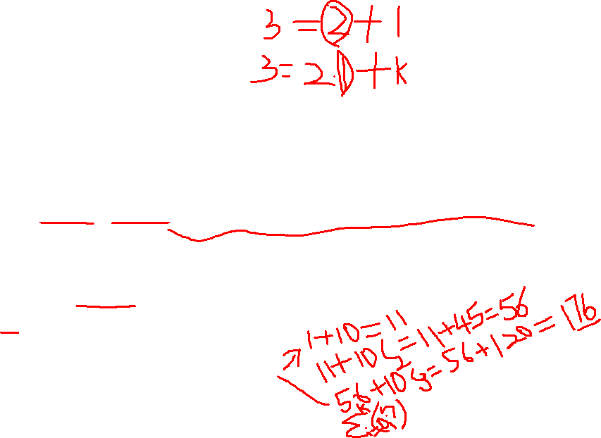
Ex:
1. With w ∈ Z₂² Let E: W- > Z₂⁶ be given by
E(00)=000000
E(01)=010101
E(10)=101010
E(11)=111111
Here the minimum distance between the code words is 3, so we can detect double errors and correct single errors.
2. With S(000000,1) = {000000,100000,010000,001000,000100,000010,000001}, the decoding function D: Z₂⁶ -> Z₂² , gives D(x)=00 for all x ∈ S(000000,1).
3. Similarly S(010101,1) = {010101, 110101, 000101, 011101, 010001, 010111, 010100} here D(x)=01 for all x ∈ S(010101,1).
4. a) If x ∈ Z₂¹⁰, determine |S(x,1)|, |S(x,2)|, |S(x,3)| .
b) For n,k ∈ Z⁺ , 1≤k≤n, if x ∈ Z₂^{n}, what is |S(x,k)|?

Slide 14
Parity check and Generator matrices
Here the encoding and decoding functions are given by matrices over Z₂. One of the matrices will help to locate the nearest code word for a given received word. This will be helpful when set c of code words is larger.
Ex: 1 0 0 1 1 0
G= 0 1 0 0 1 1
0 0 1 1 0 1
Be a 3x6 matrix over Z_{2.} First three columns forms an identity matrix of 3x3 that is I₃.
Let A denote matrix formed by last 3 columns of G. We can write G = [I₃ | A] to denote its structure. The partition matrix G is called the Generator matrix.
We use G to define encoding function E : Z₂³ -> Z₂⁶ as follows:
For W ∈ Z₂³ , E(W) = W.G is the element in Z₂⁶ obtained by multiplying W, considered as a three dimensional row vector, by G on its right. In the calculation, we have 1+1=0 not 1+1=1

Slide 15
Examples:
E(110)= (1 1 0) G = 1 0 0 1 1 0
[ 1 1 0 ] 0 1 0 0 1 1 = [ 1 1 0 1 0 1 ]
0 0 1 1 0 1
E(010)= (0 1 0) G = 1 0 0 1 1 0
[ 0 1 0 ] 0 1 0 0 1 1 = [ 0 1 0 0 1 1 ]
0 0 1 1 0 1
Note that E(110) is obtained by adding first two rows of G, where as E(010) is the second row itself.
The set of code words obtained by this method are:
C={000000,100110, 010011, 001101, 110101,011110,101000,111000} ∈ Z₂⁶
One can obtain the corresponding message by dropping last 3 components of the code word.
In addition, the minimum distance between the code words is 3, so we can detect the errors of wt≤2 and correct single error.

Slide 16
For all w=w₁w₂w₃ ∈ Z₂³ , E(w) = w₁w₂w₃ w₄w₅w₆ ∈ Z₂⁶.
Since E(w)= [w₁w₂w₃ ] 1 0 0 1 1 0
0 1 0 0 1 1 = [w₁w₂w₃ (w₁+w₃) (w₁ +w₂) (w₂ +w₃)
0 0 1 1 0 1
We have w₄= w₁+w₃ w₅ = w₁ +w₂ w₆ = w₂ +w₃ and these equations are called parity check equations. Since w_{i} ∈ Z₂ for each 1≤i≤6, it follows that w_{i}=-w_{i} and so the equations can be written as
w₁ + w₃+ w₄ = 0
w₁ + w₂ + w₅ = 0
w₂ + w₃ + w₆ = 0
Thus we find that 1 0 1 1 0 0 w₁ 0
1 1 0 0 1 0 w₂ = H ((E(w)^{Tr}) = 0
0 1 1 0 0 1 w₃ 0
w₄
w₅
w₆
ś

Slide 17
If r₁r₂r_{3…..} r₆ ∈ Z₂⁶ , we can identify r as a code word if H r^{Tr} = 0
0
Writing H as [B| I3] , we denote B= A^{Tr} 0
Suppose we receive r= [ 110 110 ]. We want to find the code word c that is nearest neighbor of r. If there is a long list of code words against which to check r, we first examine H r^{Tr} , which is called as a syndrome of r. Here,
1 0 1 1 0 0 1
H r^{Tr =} 1 1 0 0 1 0 1 0
0 1 1 0 0 1 0 = 1
1 1
1
0
So, r is not a code word. Hence we at least detect an error. Looking at the list of code words, we see that d(110110, r )=1 Here syndrome matches with second column. So by flipping second bit of r, we get 100110. By discarding last three bits, decoded word is 100.
ś

Slide 18
For all other c ∈ C, d(r,c)≥2. Writing r=c+e, 100 110 + 010000, we find that transmission error (of wt 1) occurs in second component of r.
Suppose 1 is in i^{th} component of e, 1 ≤ i ≤6, then H r^{Tr}= H(c+e)^{Tr}= Hc^{Tr}+ He^{Tr}
= He^{Tr} Since Hc^{Tr}=0
= i^{th} column of H
Ex: Suppose we receive r=000 111, find syndrome.
1 0 1 1 0 0 0
H r^{Tr =} 1 1 0 0 1 0 0 1
0 1 1 0 0 1 0 = 1
1 1
1
1
So, r is not a code word. Here syndrome does not match with any column. But this syndrome can be obtained by sum of 2 columns – 1st and 6th or 2nd and 4th or 3rd and 5th . So we get 3 code words, 100110, 010011 and 001101 respectively by flipping 1st and 6th or 2nd and 4th or 3rd and 5th bits of received word. So, we cannot expect H to correct multiple bit errors. This is because minimum distance between code words is 3.

Slide 19
Ex:
With G= 1 0 0 1 1 0
0 1 0 0 1 1
0 0 1 1 0 1 ,
Find code word for 011 and 100
Find the decoded message for 100110 and 111101
Soln: 1 0 0 1 1 0
i) c = [ 011 ]G = [0 1 1] 0 1 0 0 1 1 =[ 0 1 1 1 1 0]
0 0 1 1 0 1
1 0 0 1 1 0
i) c = [ 100 ]G = [1 0 0] 0 1 0 0 1 1 =[ 1 0 0 1 1 0]
0 0 1 1 0 1

Slide 20
Ex:
With G= 1 0 0 1 1 0
0 1 0 0 1 1
0 0 1 1 0 1 ,
ii) Find the decoded message for 100110 and 111101
Soln: For decoding , we need H matrix =
1 0 1 1 0 0
1 1 0 0 1 0
0 1 1 0 0 1
1 0 1 1 0 0 0
Syndrome of r is given by H . r^{Tr}= 1 1 0 0 1 0 [ 1 0 0 1 1 0]^{Tr} = 0
0 1 1 0 0 1 0
1 0 1 1 0 0 1
Syndrome of r is given by H . r^{Tr}= 1 1 0 0 1 0 [ 1 1 1 1 0 1]^{Tr} = 0
0 1 1 0 0 1 1
In first case syndrome is 000, so code word is correct and decoded word is 100; in second case syndrome matches with 3rd column, by flipping 3rd bit corrected code word is 110101and discarding last 3 bits decoded word is 110.

